Slide 1
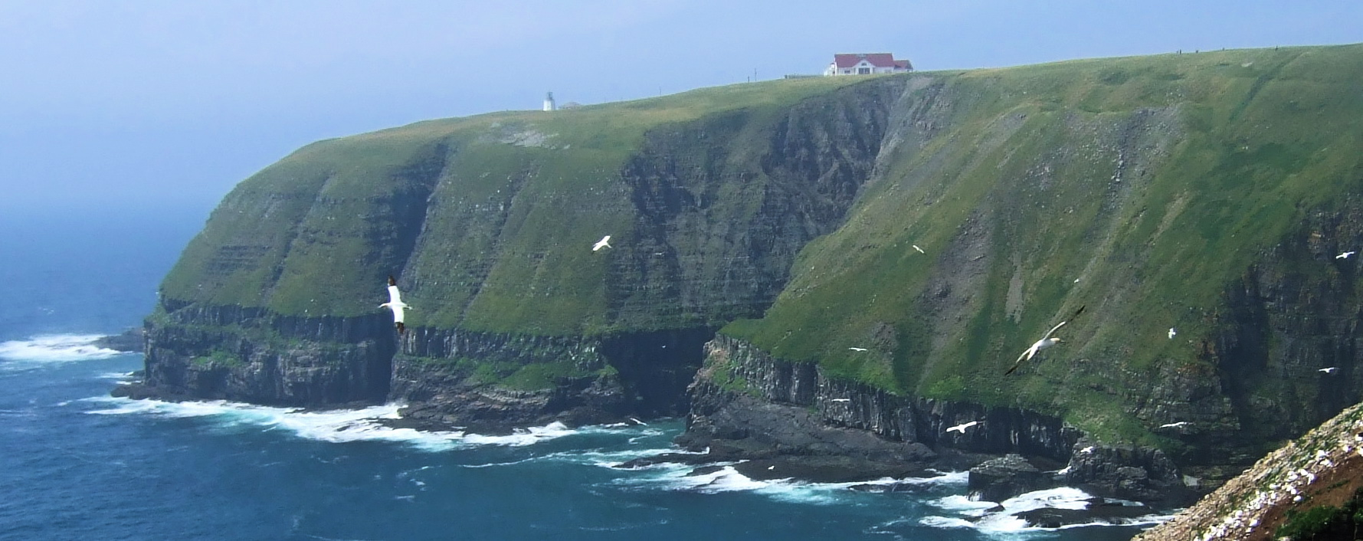
Ecological Psychology
Beyond Descartes’s dilemma:
It takes more than mechanical behavior and free thinking to save us

Slide 2
Beyond the Cartesian Dilemma and Behaviorism and Cognitivism
Behaviorism –
a. psychology is the study of behavior
b. behavior is a consequence of what the environment does to the animal
c. learning is the central task of animals
d. learning is a general, mechanistic process based on repetition and reward
e. animals’ actions are in search of rewards (signaled by positive feelings)

Slide 3
Beyond the Cartesian Dilemma and Behaviorism and Cognitivism
Behaviorism –
a. psychology is the study of behavior
b. behavior is a consequence of what the environment does to the animal
c. learning is the central task of animals
d. learning is a general, mechanistic process based on repetition and reward
e. animals’ actions are in search of rewards (signaled by positive feelings)
Cognitivism –
a. Psychology is the study of thinking (remembering, imagining, reasoning, etc.)
b. Behavior is a consequence of thought (conscious or unconscious)
c. Representation and computation are the central tasks, and these occur in a hidden mind which is implemented in the brain
d. Representation and computation are constructive and interpretive
e. People use mental models to guide actions, which are in search of control -- make the others and world do what I want

Slide 4
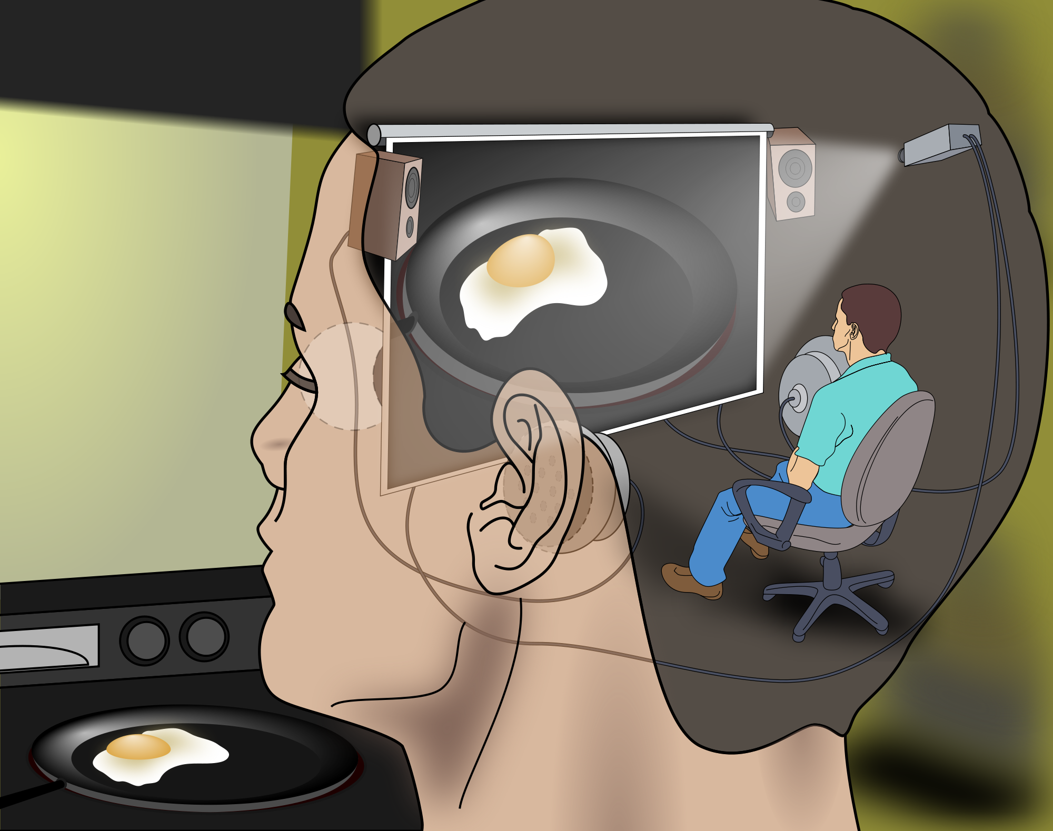
The Cartesian Theater
Vision involves receiving sensations from the retina, which then are transmitted to various brain regions to be analyzed and processed into a meaningful perception
Shape, movement, color, texture, etc. are analyzed separately and then reassembled and integrated into an interpretive representation, according to the brain’s own rules (e.g., schemas, biases, categories)
Thus, we do not see the world accurately and directly; in fact, we do not really see the world at all, only our constructed representation of our sensory experience

Slide 5
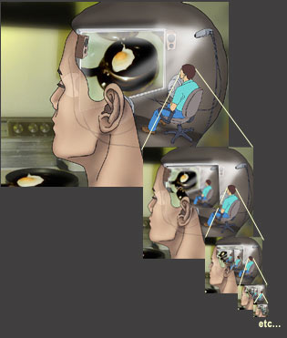
One problem –
Infinite Regress
But the deeper and more basic problems are:
1. separation of the person (or other animal) from their environment
2. separation of action and perception (or doing and knowing)
3. instead of focusing on relationships, there is a focus on autonomous activity (e.g., “the brain’s own rules”)

Slide 6
Some key assumptions of cognitivist theories:
The world is not ordered, meaningful, or valuable in itself; or, at least our impressions (e.g., sensations) of it are insufficient (e.g., too ambiguous, too impoverished, or too overwhelming) to provide adequate guidance
2. Meaning must be given to the world --- the world provides “inputs” but before these can make sense and provide adequate guidance for action, they must be “processed” (or “interpreted”, “enriched”, “simplified”, etc.)
Cognition is the activity of developing of theories, models, schemas, or grammars that can organize and enrich experience so that it makes sense

Slide 7
By contrast,
An ecological approach to psychology –
tries to look at the larger set of relationships within which a person or animal is embedded
Examples of ecological (or relational) approaches you have encountered previously:
Ecological rationality of Gigerenzer ---
learning to assess the nature of the situation –
e.g., How uncertain is the decision to be made?
How much prior knowledge do I have about this domain?
How reliable and accurate are the sources of information I have?
All of this is crucial for deciding what heuristics are most applicable.

Slide 8
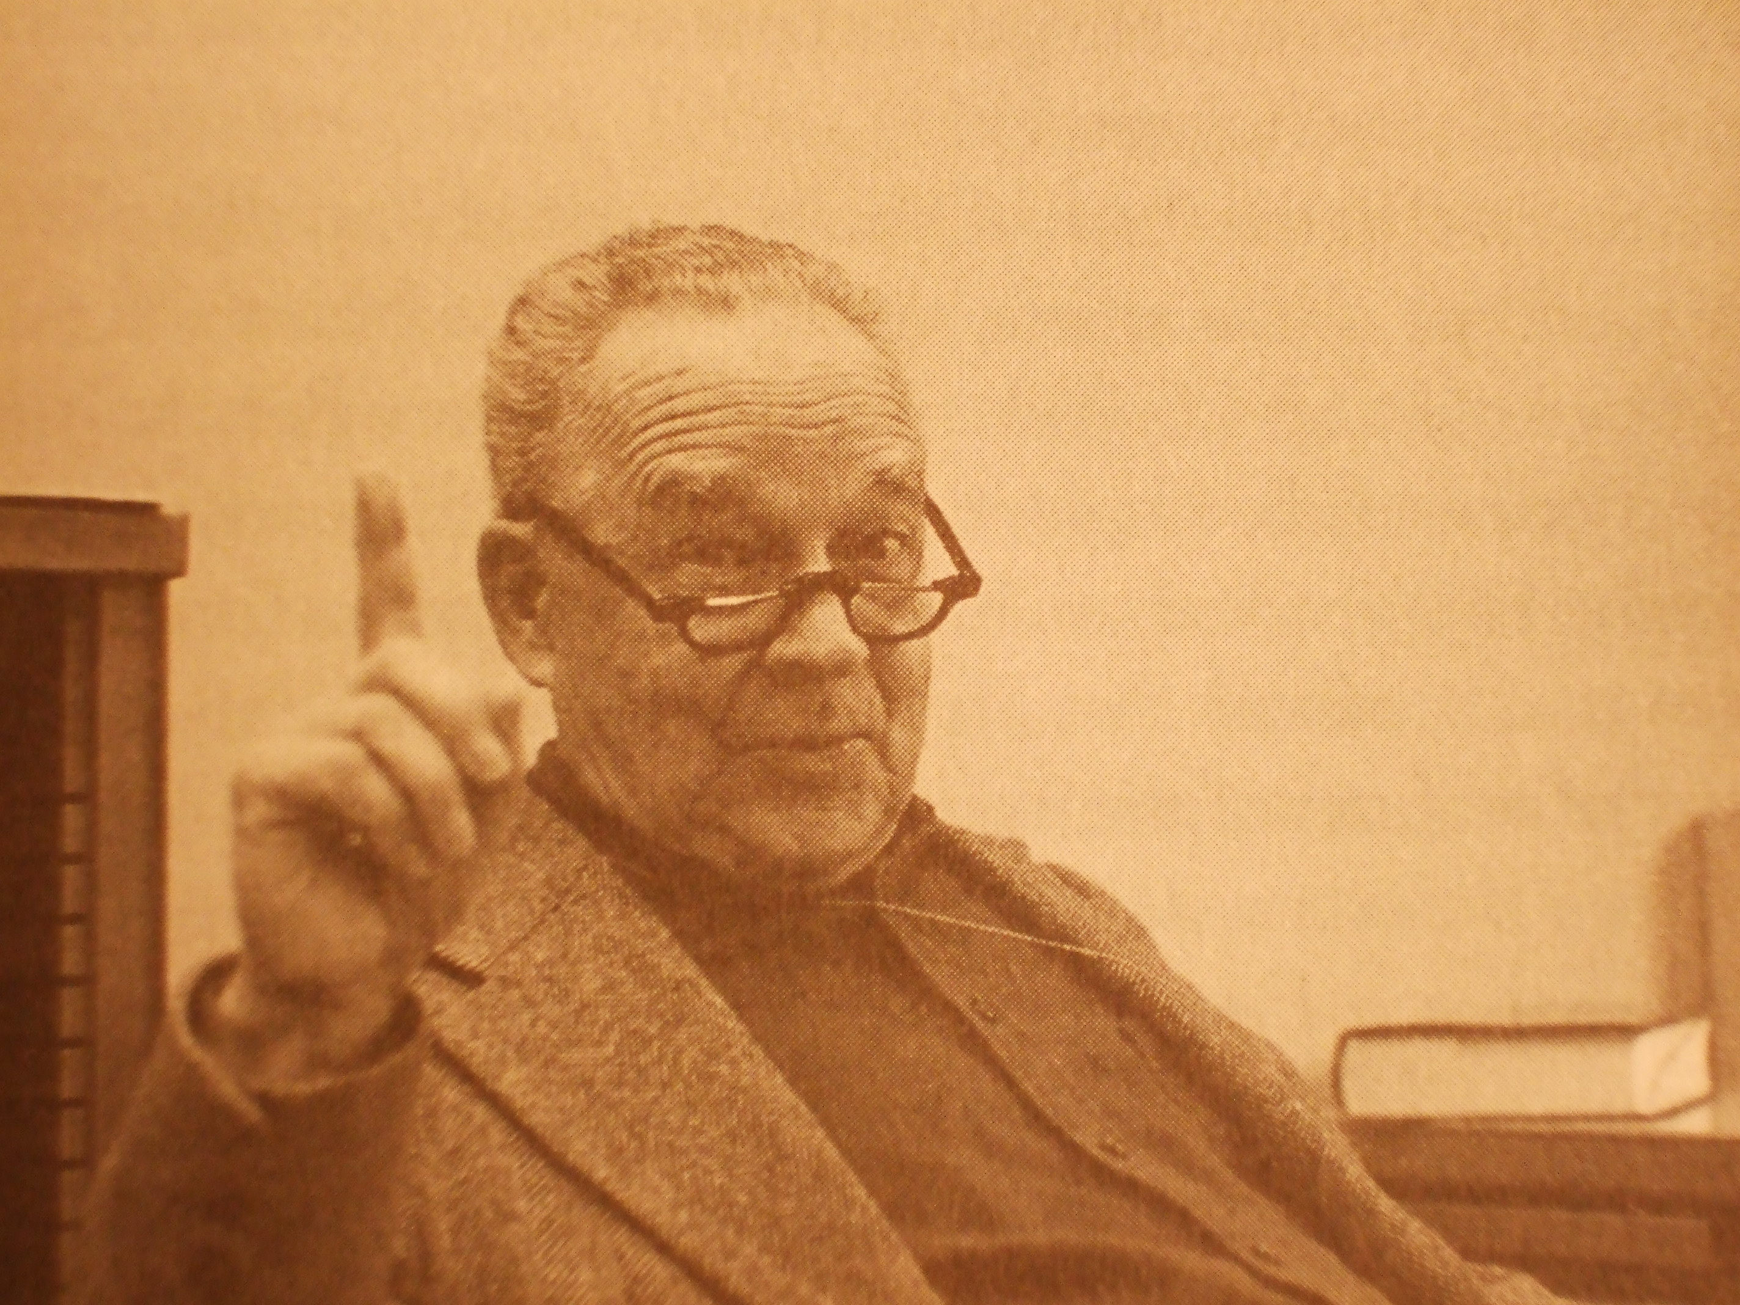
The best known ecological approach to psychology emerged from the work of
James J. Gibson (1904-1979)
on perception, particularly vision
Prior to Gibson, the psychology of vision started with the retinal image, which had to be processed, interpreted, or enriched.
Experiments used very brief visual presentations,
or people were allowed to look at something, often with only one eye from one, and only one, perspective

Slide 9
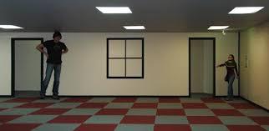
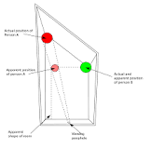
The main finding of all these studies was that perceptions were ambiguous or distorted
A fabulous example of this is the distorted room, first built and researched by Ames

Slide 10
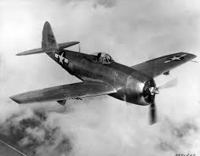

Why doubts arose for Gibson about the traditional view of perception
flight studies
Everything was moving: plane, head, eyes
But no confusion, even in unfamiliar environment
Head movement which altered inner ear organs for orientation (e.g., semicircular canals) did not disorient, but made visual perception clearer
Films of landing shown to novices--- they could tell when approaches were too steep and crashes were imminent

Slide 11

Why doubts arose for Gibson about the traditional view of perception
Gibson’s “new” problem—
On what basis are people able to guide their actions so precisely and flexibly, so accurately and successfully?
How is it that we know the world (rather than theorize about the world)?

Slide 12
Three books by Gibson (1950, 1966, 1979)
The "big idea" of each:
(1) movement improves perception (in fact, it is crucial)

Slide 13
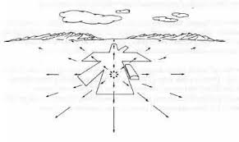
Three books by Gibson (1950, 1966, 1979)
The "big idea" of each:
(1) movement improves perception (in fact, it is crucial)
(2) direct perception based on information guides adaptive actions
invariants, revealed by movements (variants) of perceiver and objects in the world, inform actors

Slide 14
Three books by Gibson (1950, 1966, 1979)
(3) perception is exploratory activity that seeks meaning and value *
affordances – Gibson’s term for meaning & value
“what the environment offers the animal as opportunities for good or ill”
mutuality -- animal-environment is a system– each implies the other
need a new physics (e.g., ecological optics), in which world is described in terms relevant to animals
e.g., occlusion (reversible and irreversible)
________________________
* Difference from other views--- Behaviorism seeks positive feelings, Cognitivism seeks control and consistencey, and Romanticism (Humanism) seeks authenticity

Slide 15
FIVE EXAMPLES OF ECOLOGICAL RESEARCH
Example 1
Point-light displays (Johannson)
a. sensationless perceiving of structure-- both organismic and environmental-- and dynamics through motion (kinematics)

Slide 16

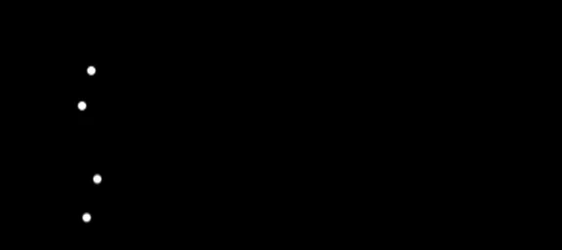
Carrying and caring

Slide 17
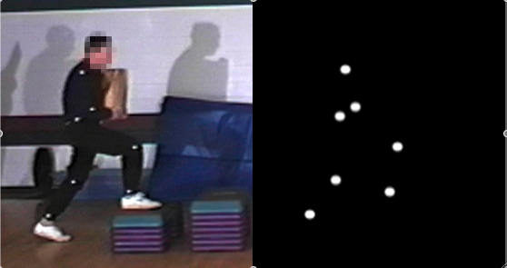
Carrying household items across irregular, gapped terrain
Hodges, B. H., & Lindhiem, O. (2006). Carrying babies and groceries: The effect of moral and social weight on caring. Ecological Psychology, 18, 93-111.

Slide 18
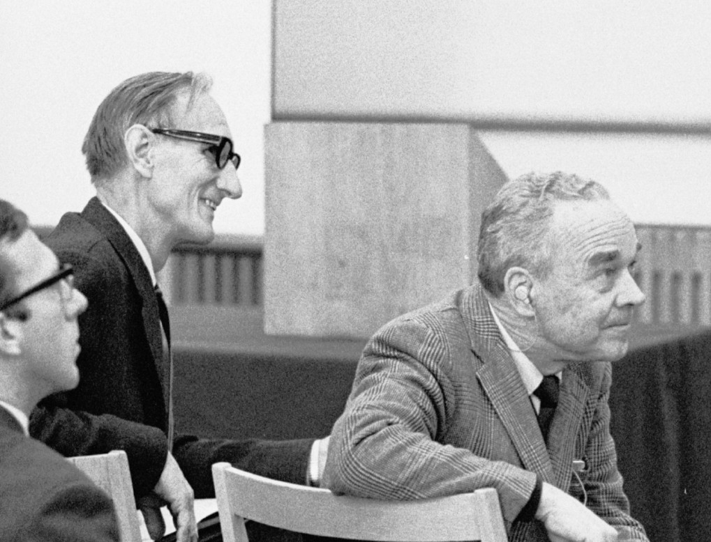
Example 1
Point-light displays (Johannson)
a. sensationless perceiving of structure-- both organismic and environmental-- and dynamics through motion (kinematics)
Gunnar
Johansson James
Gibson

Slide 19

Example 1
Point-light displays (Johannson)
b. Perceiving intentions-- Runeson & Frykholm (also Mark)
e.g., intentions to lift;
to deceive
c. Perceiving moral obligation (or, caring)-- Hodges & Lindhiem

Slide 20
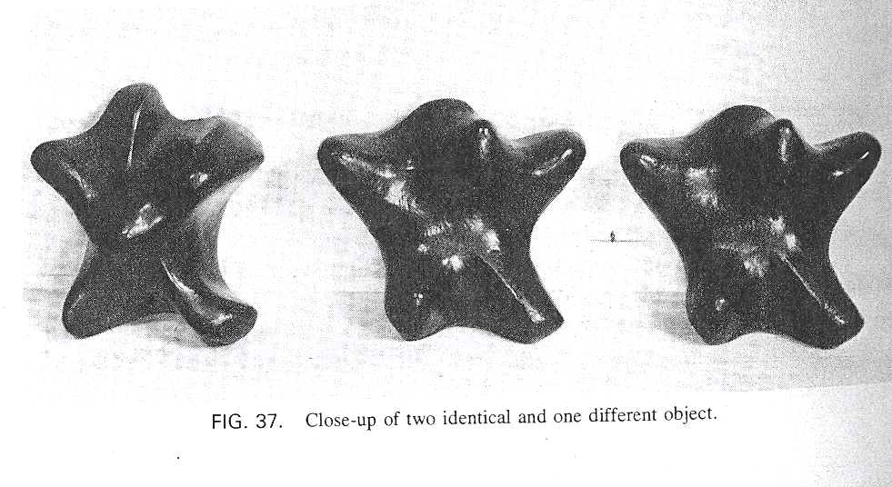
Example 2
“Feelies” experiments -- Active vs. passive touch (Gibson)

Slide 21
Example 2
“Feelies” experiments -- Active vs. passive touch (Gibson)
a. activity of perception is crucial to information pickup– never grasps whole all at once (extracts information over time)

Slide 22
Example 2
“Feelies” experiments -- Active vs. passive touch (Gibson)
a. activity of perception is crucial to information pickup– never grasps whole all at once (extracts information over time)
no ‘haptic images’ (we don’t have to integrate 5 images from 5 fingers) & skin is not in ‘indirect contact’ with environment

Slide 23
Example 2
“Feelies” experiments -- Active vs. passive touch (Gibson)
c. accuracy of identification is very high for active touch;
much less good for passive, but still good

Slide 24

Example 2
“Feelies” experiments -- Active vs. passive touch (Gibson)
c. accuracy of identification is very high for active touch; much less good for passive
d. . wielding experiments (Turvey) -- rods held in hand reveal their length through resistance to rotation (true even for “passive” holding)
Michael Turvey

Slide 25
EXAMPLE 3– GANNETS DIVING
Cape St. Mary in Newfoundland

Slide 26
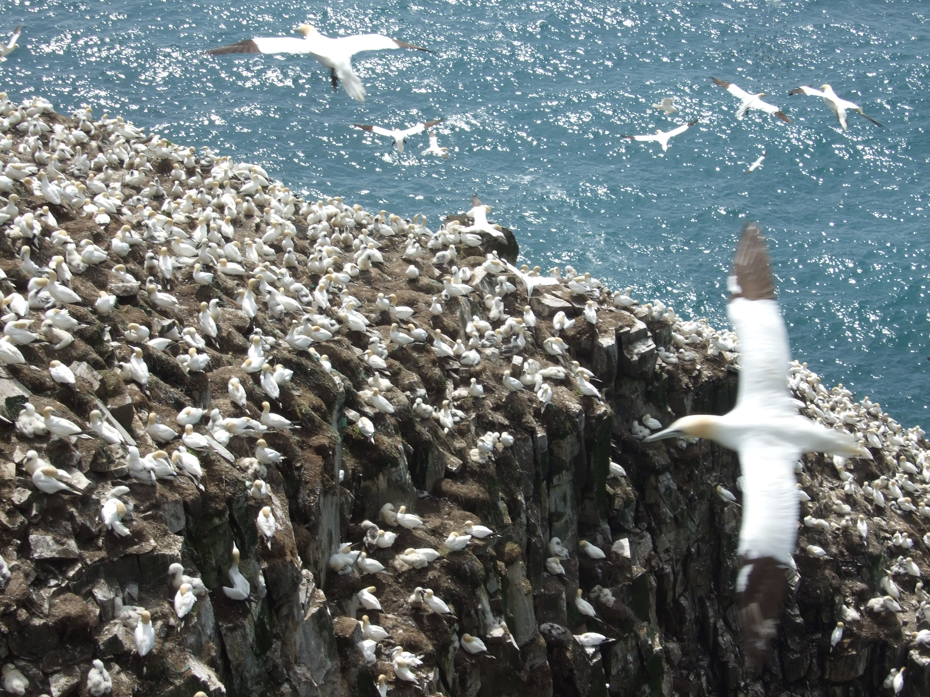

Slide 27
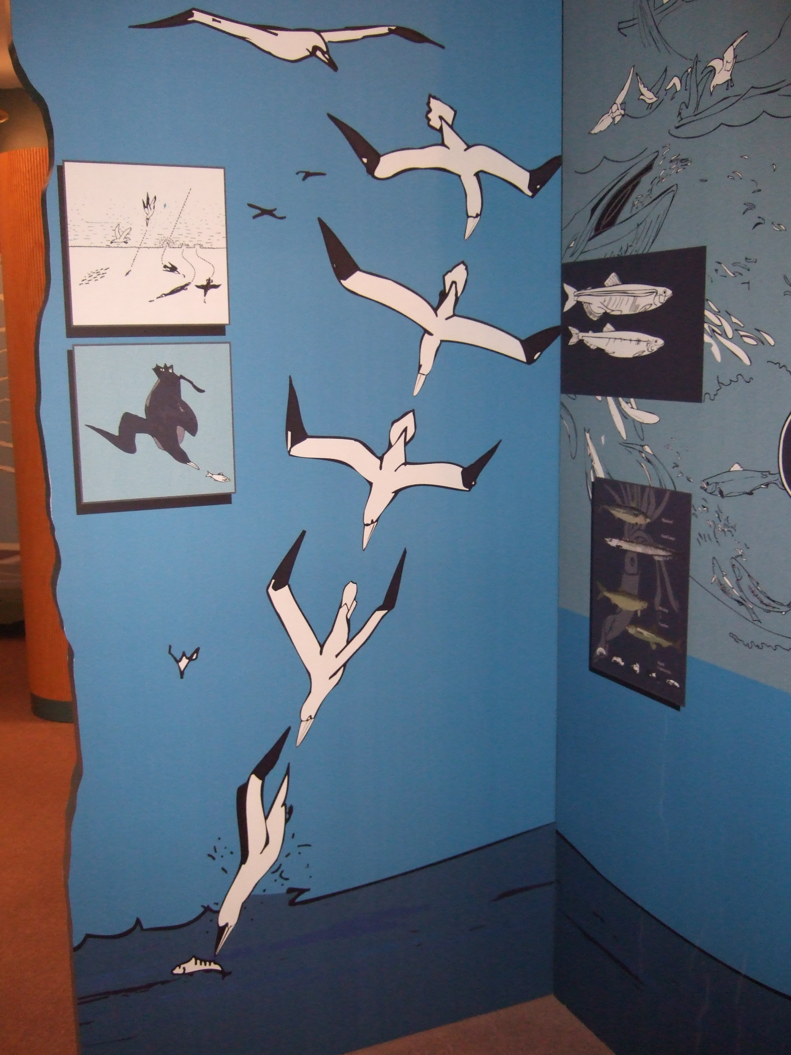
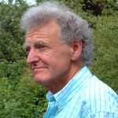
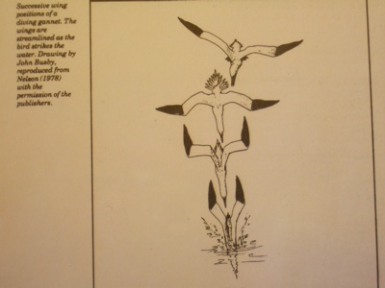
Example 3
Gannets diving (Lee)
time-to-contact
perceive timing,
not distance and speed
David Lee

Slide 28
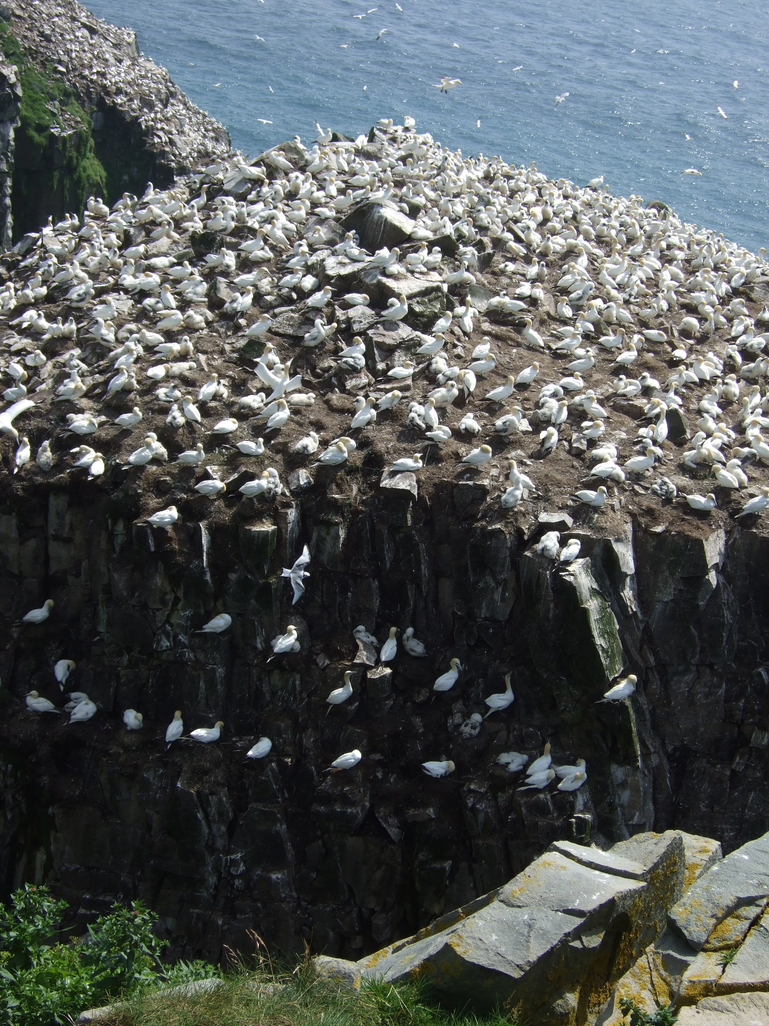
Computations
(conscious or unconscious)
are NOT necessary
Size relative to the
rate of expansion specifies
safe vs. unsafe encounters
> 1 (accelerating)
= 1 (collision)
.5 to 1 (controlled collision)
.5 (stops at contact)
< .5 (stops short of contact)

Slide 29
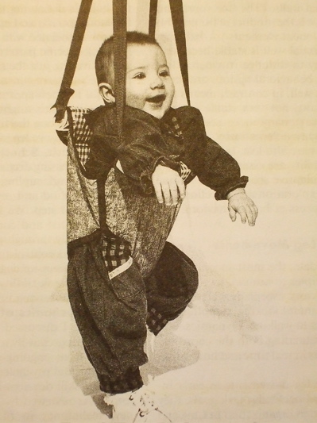
Example 4
Finding the action in a jolly jumper (Goldfield, Kay, & Warren)

Slide 30
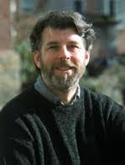

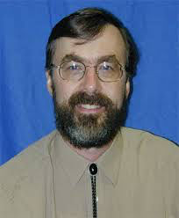
Example 4
Finding the action in a jolly jumper (Goldfield, Kay, & Warren)
a. What is the task? No instructions, no models
Bill Warren
Eugene Goldfield
Bruce Kay

Slide 31
Example 4
Finding the action in a jolly jumper (Goldfield, Kay, & Warren)
a. What is the task? No instructions, no models
b. Novel task-- no evolutionary preparation, no pre-tuned neural codes

Slide 32
Example 4
Finding the action in a jolly jumper (Goldfield, Kay, & Warren)
a. What is the task? No instructions, no models
b. Novel task-- no evolutionary preparation, no pre-tuned neural codes
c. Learning a new task is discovery through action– this requires child to modify their current action patterns

Slide 33
Example 4
Finding the action in a jolly jumper (Goldfield, Kay, & Warren)
a. What is the task? No instructions, no models
b. Novel task-- no evolutionary preparation, no pre-tuned neural codes
c. Learning a new task is discovery through action– this requires child to modify their current action patterns
d. If child spontaneously (or through guidance of others) gets “into the ballpark” of a particular set of affordances (e.g., bouncing up and down with minimal energy inputs), his/her actions will be attracted to this configuration (what a physicist would call the “resonant frequency of a forced mass spring”).
The whole system of dynamics that involves the child, the jumper, etc., seeks and finds the “most bounce for the ounce.”

Slide 34
Example 4
Finding the action in a jolly jumper (Goldfield, Kay, & Warren)
e. What is the motivation?
The task itself. The child discovers how to tune their actions so that the affordances of the environment fit with their own abilities, so that that the “joy of play” can be realized.

Slide 35
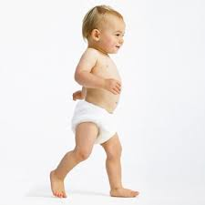
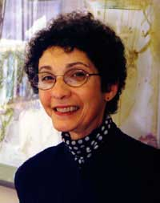
Example 5
WALKING – What is it? Where is it?
Actions change the positions and postures of the animal
and often change the relation between the animal and the environment
Esther Thelen – developmental psychologist

Slide 36
Example 5
WALKING – What is it? Where is it?
Actions change the positions and postures of the animal
and often change the relation between the animal and the environment
ACTIONS: They are in the environment as much as in the animal. Animals and their nervous systems are always active.
Normal organism is in a dynamical state of disequilibrium.
Where is walking? How does it develop?
Esther Thelen

Slide 37
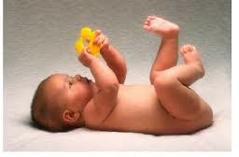
Walking
Newborns walk, but stop walking at 2 months, restart at 8
months, and walk alone at 12 months (typically)
Standard story---
walking reflex, neural suppression,
release from suppression---
overall, a central maturational plan is in control

Slide 38
Walking
Newborns walk, but stop walking at 2 months, restart at 8
months, and walk alone at 12 months
Standard story--- walking reflex, neural suppression,
release from suppression--- overall, a central
maturational plan is in control
Thelen’s account—
walking is not in the brain (alone), but is a
distributed set of structures and relations–
postures, legs, media, surfaces, fields
Her first hint: Babies who gained weight the fastest were the first to stop walking

Slide 39
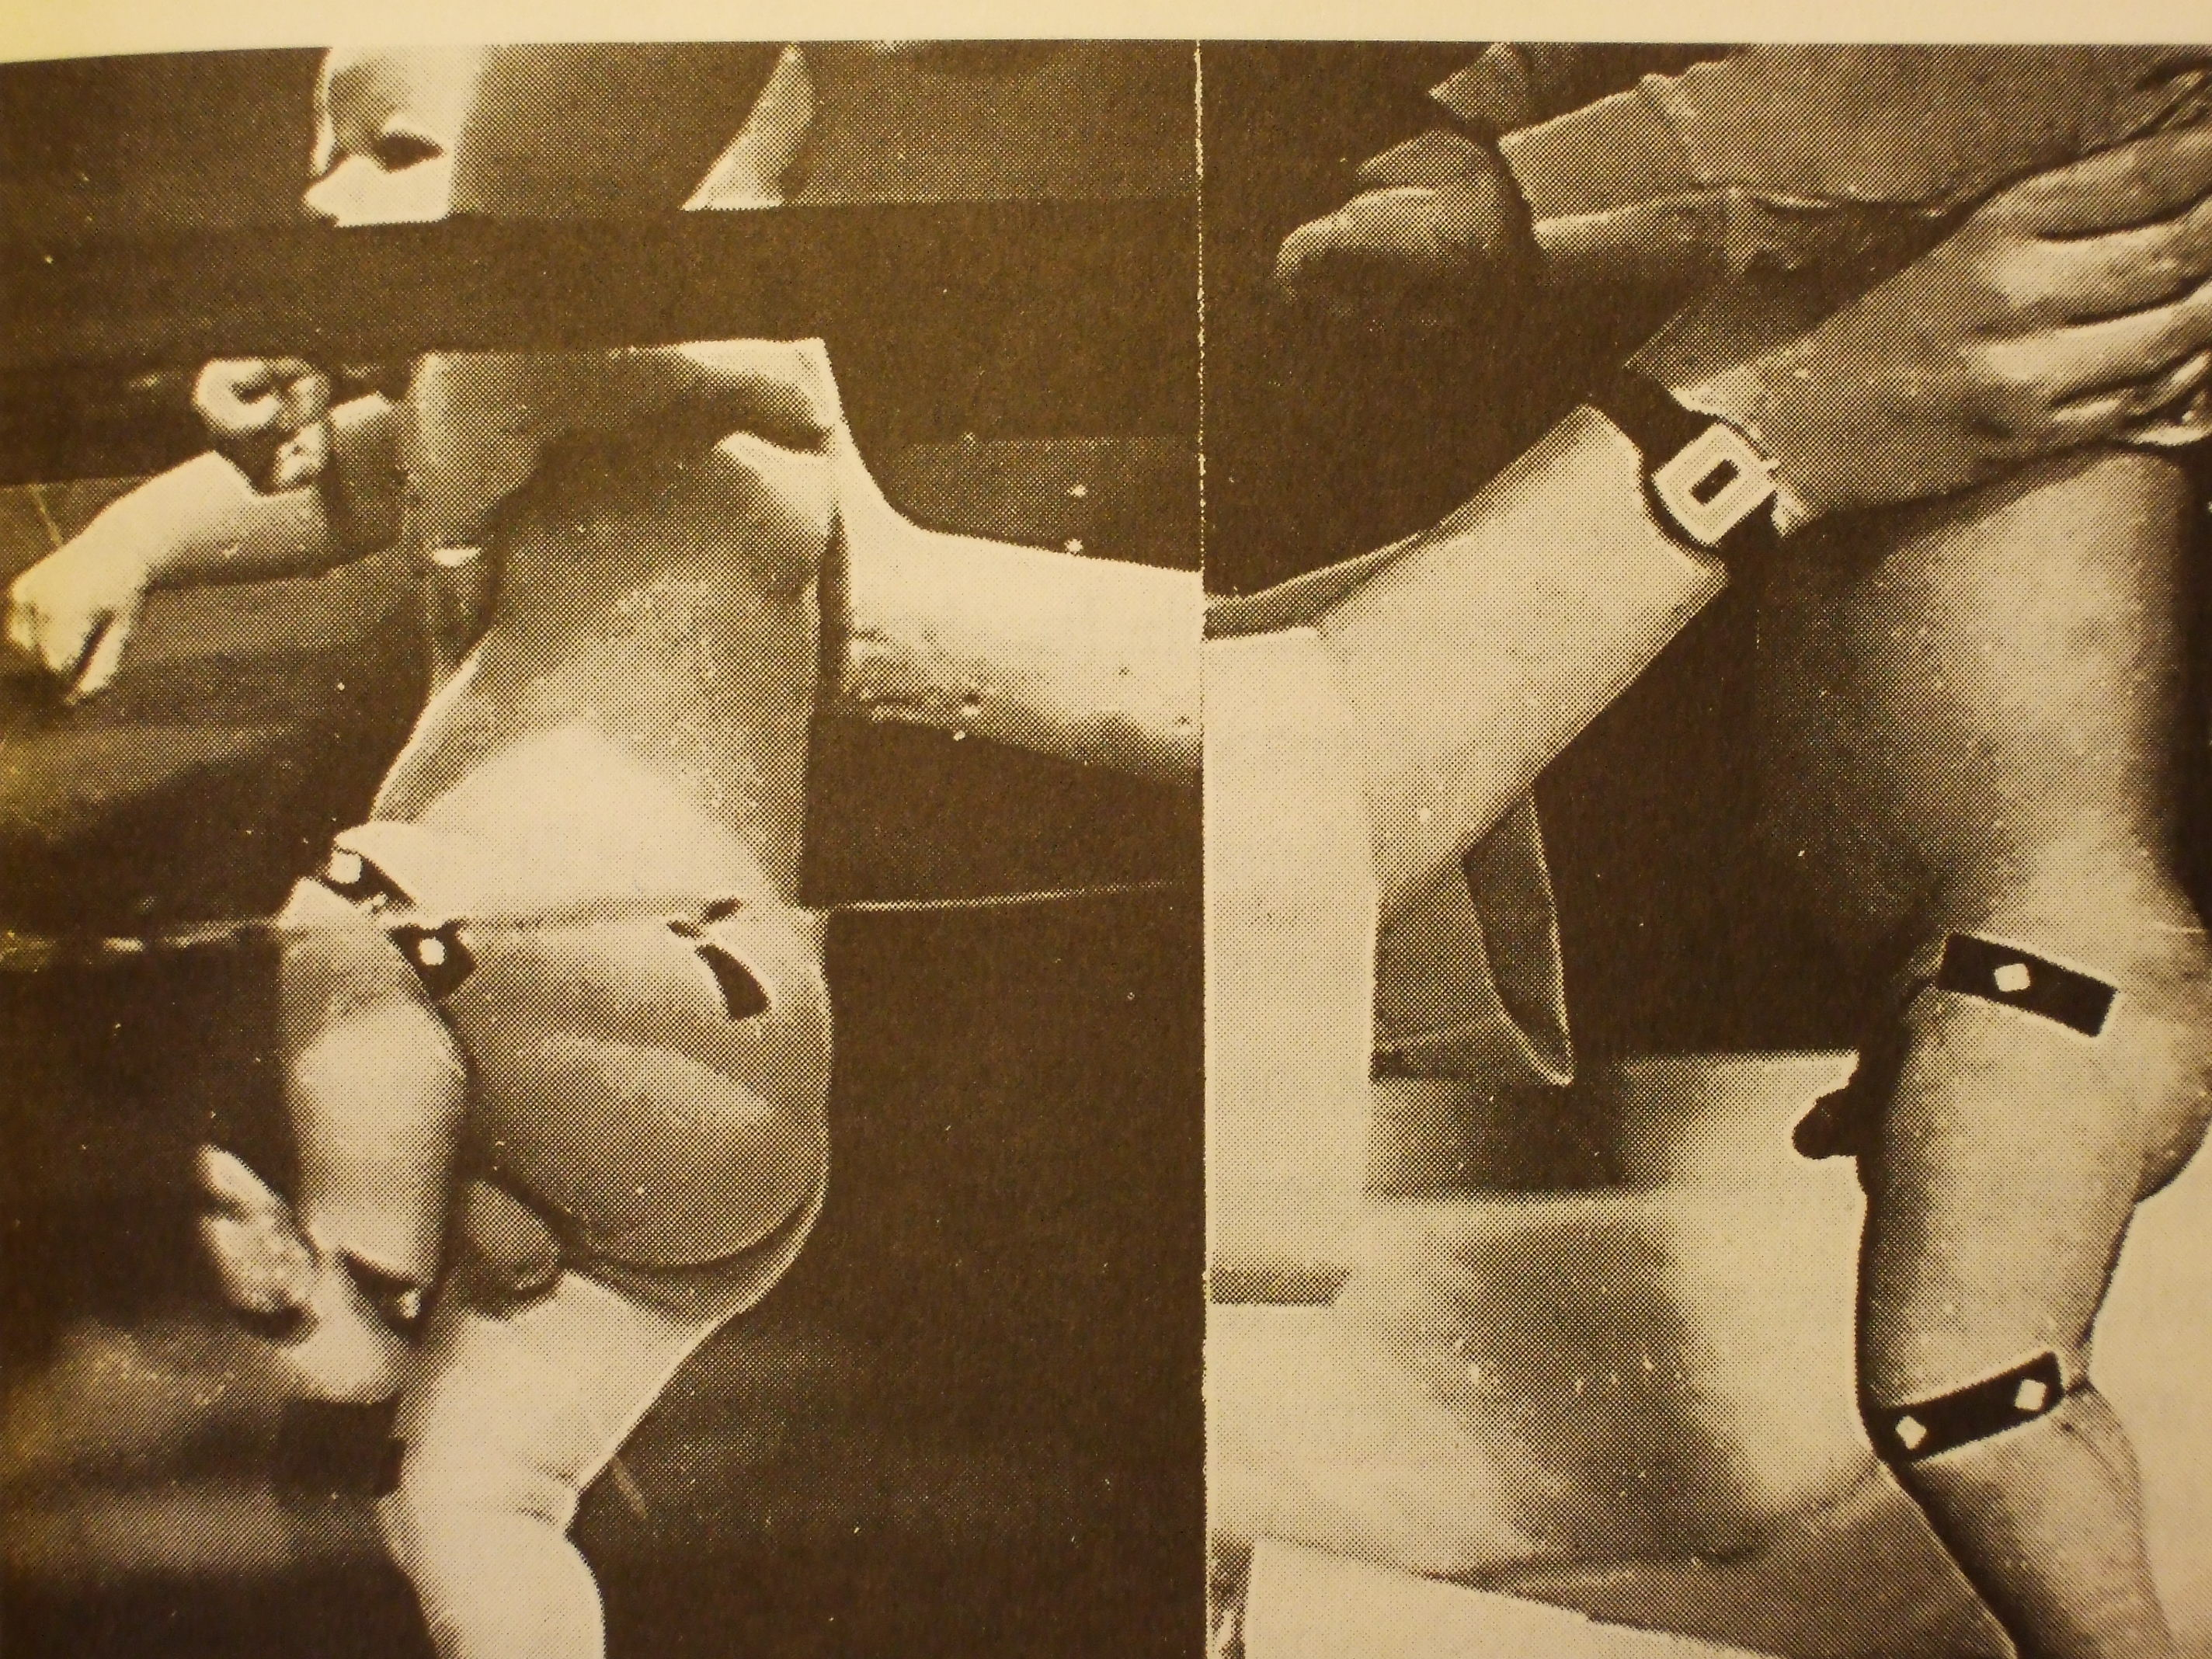
Walking
Stepping is not something someone has
Rather--
Walking is an affordance of a particular ecosystem
Thelen shows that non-walking babies can almost instantly become walking babies, and vice versa, with a variety of experimental demonstrations
Change of posture: Supine walking
Change in media: Walking in water
Change in surface: walking on treadmills (even two, moving at different speeds)
Change in weight of limbs: Adding weights to legs

Slide 40
Walking
Walking is an affordance of a particular ecosystem.
The developmental pattern is not the expression of an inner blueprint. Rather it reflects a complex interplay of forces, structures, and dynamics.
Walking is a cooperative activity among many partners.
Other researchers have demonstrated “passive walking” robots. Slight incline, slight nudge, and the right architecture and dynamics. No brain, no motor, etc.

Slide 41
Ecological Psychology
Action and perception are basic. Cognition and emotion would make no difference if there were not action and perception.
Animals belong to their environment, and environments are for their inhabitants. Psychology studies animal-environment integrity, not isolated brains, bodies, or behavior.
Agency (i.e., purposive, intelligent activity in search of meaning and value) is central to ecological psychology.

Slide 42
Ecological Psychology
Action and perception are basic. Cognition and emotion would make no difference if there were not action and perception.
Animals belong to their environment, and environments are for their inhabitants. Psychology studies animal-environment integrity, not isolated brains, bodies, or behavior.
Agency (i.e., purposive, intelligent activity in search of meaning and value) is central to ecological psychology.
The world is rich in what it offers animals for good or ill. Perceiving is the activity of the animal as a whole (not just a sensory organ or the brain) as it seeks to find what is good.
Meaning and value (affordances) are as real as anything identified by physics, and crucial to humans being social and moral agents.

Slide 43
Ecological Psychology
Action and perception are basic. Cognition and emotion would make no difference if there were not action and perception.
Animals belong to their environment, and environments are for their inhabitants. Psychology studies animal-environment integrity, not isolated brains, bodies, or behavior.
Agency (i.e., purposive, intelligent activity in search of meaning and value) is central to ecological psychology.
The world is rich in what it offers animals for good or ill. Perceiving is the activity of the animal as a whole (not just a sensory organ or the brain) as it seeks to find what is good.
Meaning and value (affordances) are as real as anything identified by physics, and crucial to humans being social and moral agents.
Actions are not caused. They are selected and organized not only by thoughts, or by anatomy, or by environmental contingencies, or by physical forces, but by all of these working together. Walking, reaching, writing, etc. are ecosystem dependent goods.

